Slide 1

The Atlanta Falcons
Juston White
Carlos Dunovant

Slide 2
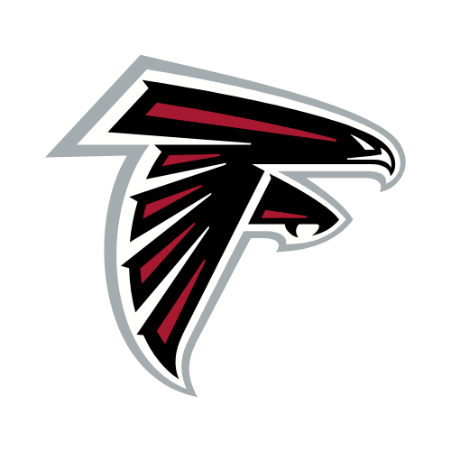
Brief History
The National Football league is a professional sports league of the best players in the world. Within this league they hold the Atlanta Falcons.
The Atlanta Falcons were founded in 1965 as an expansion team in the NFL. Up until the early 2000s the team struggled for wins and experienced many ups and downs within the franchise. The early 2000s were highlighted by the rise of Michael Vick, a dynamic quarterback known for his scrambling and playmaking ability.
The team consistently competitive in the 2010s, making the playoffs multiple times. In 2017, the Falcons reached the Superbowl, where they famously blew a 28-3 lead to the New England Patriots.
Since then, the Falcons have been rebuilding, with playoff hopes in the near future.

Slide 3
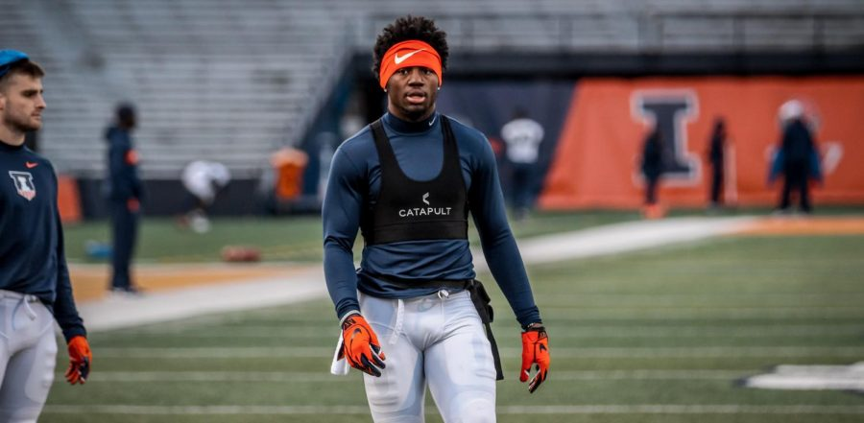
Technologies Used
The Falcons use Catapult wearable vests during practices and games. These devices track key metrics like speed, distance, acceleration, and workload.
Dartfish and Kinexon track player movements during practices and games. They use cameras and sensors to capture biomechanics and motion, offering valuable data that helps improve player form, technique, and positioning on the field.
Tools like these help the Falcons with injury prevention, in-game decision making, and even fan engagement.

Slide 4
Impact of Analytics on The Team
Analyzing thousands of data points from past games, the Falcons can identify trends that help guide play calling. This has led to more efficient use of their playbook and more effective game and time management.
For example, the road to the 2017 Super Bowl. That run can attributed to their integration of analytics into their strategy. The Falcons had a high-powered offense that season, and their use of data to optimize play calling, manage player workload, and fine-tune their attack helped them reach the biggest stage.

Slide 5
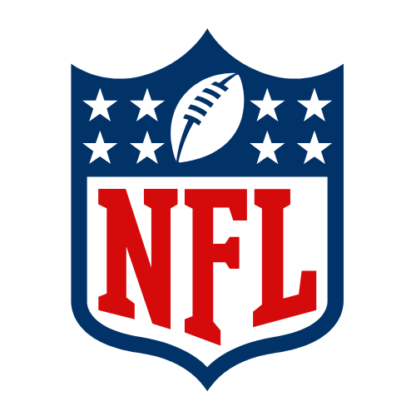
Analytics in The NFL
The NFL, like many other sports, has undergone a major transformation due to the rise of sports analytics. These advancements have changed not only how the game is played and coached but also how fans interact with it.
While sports analytics has advanced across major sports, the NFL has developed unique approaches to meet the game’s specific needs, especially in player tracking and strategy. Although trends like machine learning and predictive analytics are seen in baseball and basketball, the NFL’s physical demands and game structure have led to specialized applications. These innovations help optimize performance, adjust strategies, and improve the fan experience, setting the NFL apart from other leagues.
Analytics has improved competitive balance in the NFL by helping smaller teams make smarter decisions, closing the gap with better teams. Fans benefit from a more engaging experience through real-time data, interactive tools, and fantasy football insights. Coaches and front offices use analytics to refine strategies and make better player decisions during drafts. Overall, analytics has made the game more strategic, accessible, and competitive.

Slide 6
Partnerships and Collaborations
The Atlanta Falcons’ collaborations with sports tech companies like Catapult and Zebra Technologies, as well as their partnerships with universities such as Georgia Tech, who they often team up with to offer students an NFL experience, have significantly shaped their approach to data-driven decisions. The integration of cloud-based platform companies and interactive features has not only streamlined their operational decisions but also enriched the fan experience, offering deeper insights into the game. Ultimately, these partnerships have allowed the Falcons to stay ahead of the curve in the NFL, enhancing both their competitive edge and their ability to engage with fans in meaningful, data-driven ways.

Slide 7
Works Cited
https://operations.nfl.com/learn-the-game/nfl-basics/team-histories/national-football-conference/south/atlanta-falcons/#:~:text=Team%20History,suggested%20the%20%E2%80%9CFalcons%E2%80%9D%20name.
https://www.atlantafalcons.com/news/atlanta-falcons-offense-4-stats-that-illustrate-growth
https://www.britannica.com/topic/Atlanta-Falcons
https://www.atlantafalcons.com/team/partners
https://knowablemagazine.org/content/article/technology/2024/how-next-gen-data-analytics-changing-american-football

